Slide 1
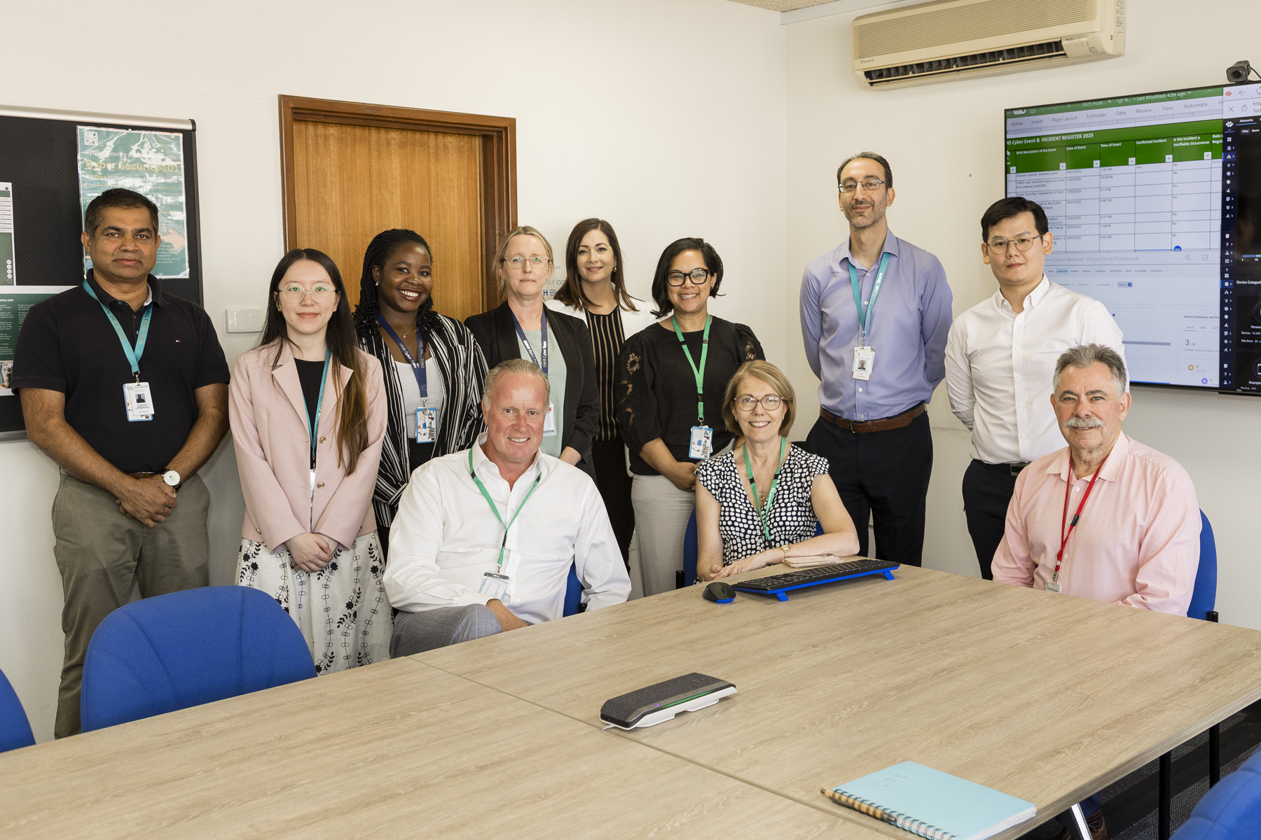
March 2025
EMHS Board Communique
The latest news, views, and announcements
This communique highlights key discussions and considerations of the EMHS Board meeting held on Tuesday 25 March 2025 at EMHS Chief Executive Office
Board Members Present:
Ms Pia Turcinov AM | Board Chair
Dr Denise Glennon | Deputy Board Chair
Mr Ross Keesing | Board Member
Mr Peter Forbes | Board Member
Prof. Tracey Moroney | Board Member
Ms Vanessa Elliott AM | Board Member
Mr Andrew Whitechurch | Board Member
Ms Melissa Grove | Board Member
Left to right: Prasanna Morendage (Cyber Security Analyst), Shurui Lian (Cyber Security Analyst), Sonia Arika (Cyber Security Coordinator), Andrew Whitechurch (Board Member), Gillian Lonergan (Manager Cyber Security, Risk & Compliance), Grace Hockey (A/Chief Cyber Security Officer), Melissa Grove (Board Member), Tracey Moroney (Board Member), Paul Perdichizzi (A/Manager Cyber Security Operations), Ashton Wong (Business Resilience Coordinator), Ross Keesing (Board Member).

Slide 2
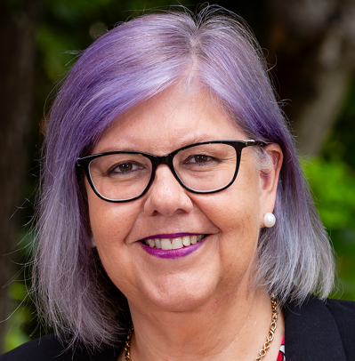
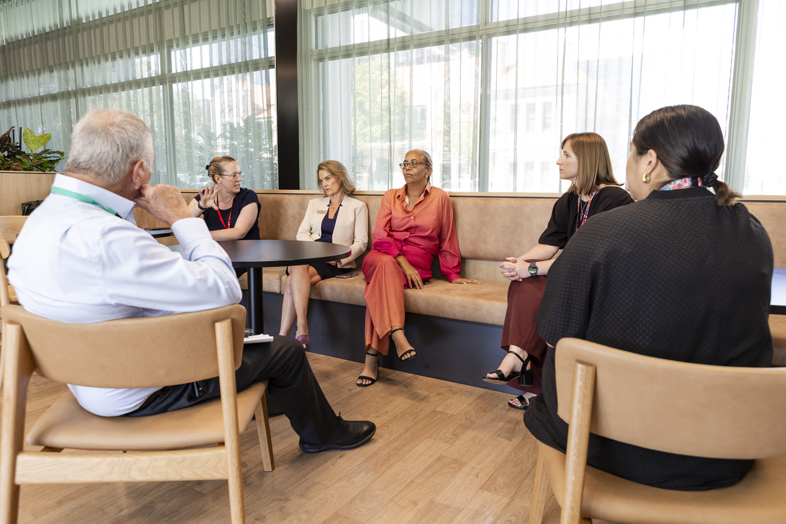
Board Chair – Ms Pia Turcinov
Board Members participated in three leader rounding sessions, touring Cyber Security, Procurement and Contract Management, the Eating Disorder Specialist Service and the Innovation Hub.
The Board noted the new health related portfolios and the appointments announced by the Premier’s Office.
Several Board Members attended the EMHS 2024 Values in Action Award Ceremony.
Ms Turcinov and Chief Executive, Dr Lesley Bennett attended the Key Issues Meeting with the Director General to discuss various matters concerning EMHS.
EMHS Board Committee Reports
Board Operational Performance and Strategy:
The Committee discussed EMHS Digital Strategy which includes a focus on an uplift of the Staff Intranet Hub and assessing service delivery following changes within the directorate.
The Committee was provided with an update on the Electronic Medical Records project.
Discussions around People and Culture included proactive management of aggression and violence, worker’s compensation, Aboriginal Health and the Plan for Our People.
The Committee also discussed Clinical Service and Public Health Planning.
Board Finance:
The Committee discussed EMHS’ financial position and activity.
The Committee reviewed the state of the major and minor capital works projects across the organisation.
Left to right: Peter Forbes (Board Member), Kirstie Kemble (Program Manager, Statewide & Specialty Mental Health Services), Denise Glennon (Board Member), Vanessa Elliott (Board Member), Linda Tierney (Service Manager EMEDSS), Rebecca Ng (Consultant Psychiatrist EMEDSS).

Slide 3
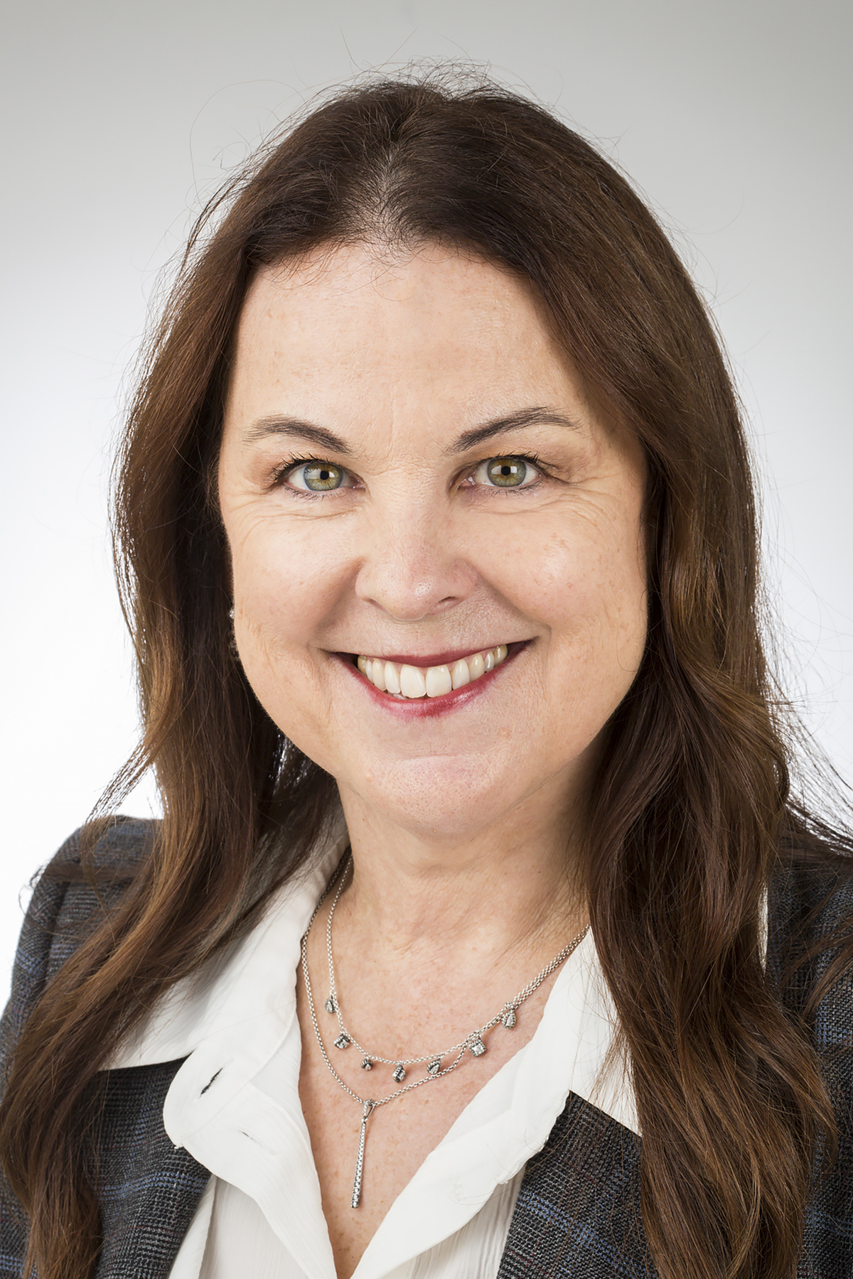


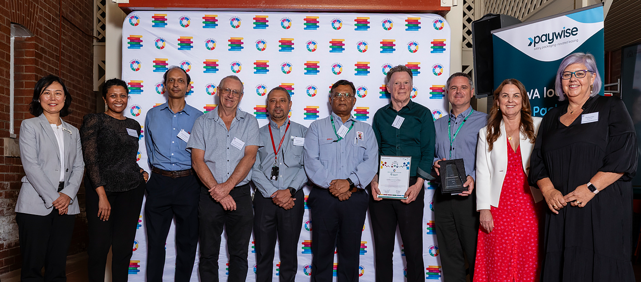
EMHS Chief Executive – Dr Lesley Bennett
Dr Bennett provided the Board with an overview of the new series of Health Executive Committee meetings for 2025.
The Board noted the progress being made on the Demand and Capacity Optimisation Program and the focus on Aged Care, system flow and Hospital in the Home beds.
Preparations for winter are underway with EMHS’ Winter Plan including streamlining pathways to Home Hospital and the possibility of repurposing existing resources.
EMHS Site Updates
Armadale Kalamunda Group (AKG)
Service expansion and patient flow is a major focus for AKG to address demand requirements.
eOrdering of imaging services have commenced this month at Armadale Hospital
Royal Perth Bentley Group (RPBG)
Bentley Hospital is on track for the roll out of Digital Medical Records this month.
Accreditation preparation is currently underway
Presentations to the Board:
The Board welcomed Dr Shirley Bowen Director General, Department of Health to this months’ Board Meeting to discuss matters across EMHS and WA Health.
EMHS Values in Actions Winners. Left to right: Nina Gao (Account Manager, Paywise), Chandima Hiyare-Hewage (A/Executive Director, Infrastructure), Hitesh Pandya (Shift Engineer), Christopher Burden (Electrician), Denzil Padua (Facilities Supervisor), Ramesh Patel (A/Shift Engineer), Graeme Edwards (Campus Facilities Manager, Armadale), Richard England (Director Facilities Management), Lesley Bennett (Chief Executive), Pia Turcinov (Board Chair). Absent: Robert Kerrigan (Assistant Operations Manager, Edgardo Garrido (Project Coordinator).

